Slide 1



CrowdFunding Analytics
PPT Presentation By:
D.Srimannarayana
K.Shivanand
V.Pavan Kumar
Anmol Krishna Dubey
Sidhasila Naik
Sebin Sabu
S.Akshaya
Project Guide : Yaragudi Asif Ahmad Sir

Slide 2


Abstract :
Crowdfunding analytics converts raw crowdfunding data into actionable insights. Creators launch projects with a funding goal and deadline, while backers support ideas by investing money. A project succeeds if the goal is met before the deadline; otherwise, it fails. This project analyzes Kickstarter crowdfunding data to identify trends and patterns that help improve creators’ success rates and enable more successful projects.
M
Introduction :
This project focuses on crowdfunding analytics, which transforms raw crowdfunding data into actionable insights. Data is extracted from the Kickstarter platform and analyzed using data analytics techniques to identify key trends and patterns. These insights help creators improve decision-making and increase the success rate of crowdfunding projects.
Tools Used For This Project :
Excel
Power bi
Tableau
MySQL

Slide 3





Data Overview
Projects Table : This Table Stores the Projects information
Projects Table Column are ProjectID, CreatorID, LocationID, CategoryID, ProjectName, Backers Count, Pleadged Amount,Goal, , Created Date, Dealine Date etc…
Locations Table : This Table Stores the Locations Information
Locations Table Column are LocationID, LocationName, Country etc…
Creators Table : This Table Stores the Creator Information
Creators Table Columns are CreatorID, CreatorName etc..
Categories Table : This Table Stores the Categories Information
Categories Table Column are CategoryID, CategoryName etc..
Excel
Data Extracting, Data Cleaning, Load Into Excel, Creating Pivot Tables, Inserting Charts & Creating Dashboards
Power BI & Tableau
Data Extracting, Data Modelling, Dax, Creating Charts, Visualizations and Dashboards
MySQL
Creating Database, creating tables load data into tables Filterings, Aggregations, Indexes, Joins etc…

Slide 4


Project Workflow
Data Extracting - Collecting Data From Sources
Data Cleaning - Clean data Removing Duplicates, Null values, Error Values, Handle the Wrong Data Types
Data Loading - Load the Data Into Excel
Calendar Table Creation - Create the Calendar table Based on Created Date column in projects table then inserted the new column that are Year, Monthname, Quarter, weekdayno, Indian Financial Month, Indian Financial Quarter
Data Modelling - Creating the relationship between the tables Based on the common column of the Tables
KPI’S Overview :
Total Projects Based on Outcome
Total Projects Based on Location
Total Projects Based on Category
Total Projects Based on Year, Month, Quarter
Successful Projects Amount Raised in US Dollars
Successful Projects Backers Count
Avg no of Days For Successful Projects
Percentage of Successful Projects

Slide 5
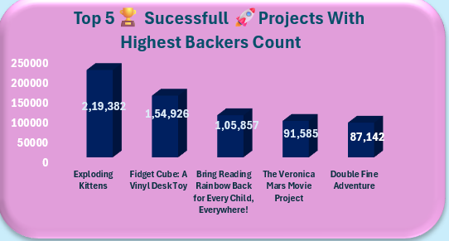
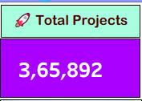
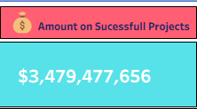
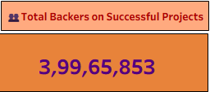
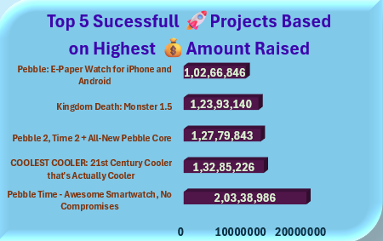
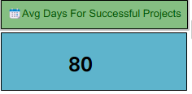
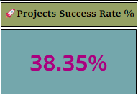
KPI’S
Total Number of Projects
Successful Projects Total Amount Raised in USD
Top 5 Successful Projects With Highest Backers Count
Successful Projects Total Number of Backers Count
AVG Number of Days Taken to Successful a Project
Percentage % Projects Success Rate
Top 5 Successful Projects With Highest Amount Raised in USD

Slide 6
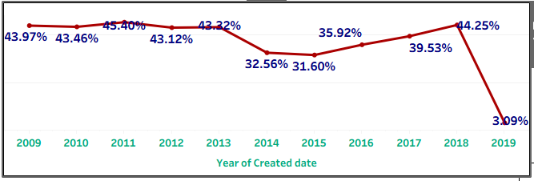
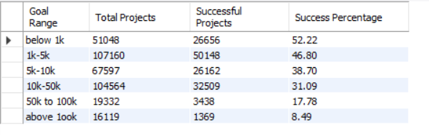
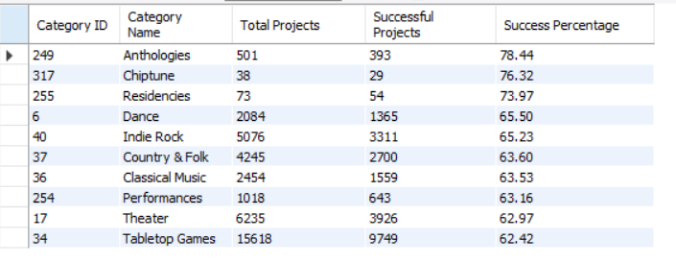
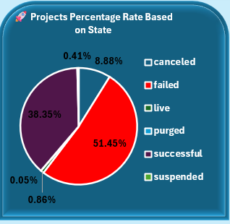
Year Wise Projects ✅ Success Rate % in Percenatage
Goal Range Wise 🚀 Projects ✅ Success Rate % in Percenatage
Using MySql Filter, aggregations and index to get Goal Range Wise Projects Success Rate %
⬆️ Top 10 Categories With Have Highest✅ Success Rate %
Percentage % of 🚀 Projects Based on Outcome

Slide 7
📉 Insights From crowdfunding 📊 analysis
After Analysis of CrowdFunding Data as Compared to Success Rate and Failure Rate if Failure Rate is Greater than the success Rate So Creators are need to Focus on Why More Projects are Failed
Less Goal Amount set then Increases the Projects Success Rate
Categories has Anthologies, chiptune, Residencies, dance, Indie Rock Please Focus on These Categories Increase the Projects on these Categories Because these Projects Success Rate is very High
Year of 2019 has Projects Success Rate is Very High Downfall so need to focus on that Year why 2019 year has Huge drop of Success Rate
After Analysis we have conclude that Highest Backers Interest on Exploding Kitchen project so Implement New Ideas on that Categories then Increases the Projects Success Rate

Slide 8
⚠️ Challenges and 📖 learnings :
⚠️ Challenges Faced During this Project :
Uncleaned Data so need More time to clean data as well as Correct the Data Types
In the Dataset the Date Format In Epoch Dates
There is no calendar Table in Dataset
In MySQL Dataset Loading got some Errors Taking Help from Project Experts and resolved the issue
📖 Learnings From This Project :
1.Converting the Epoch Date into Indian Date Format
2.Created Calendar Table from Date Column of Main Table and insert new Columns of that (Indian Financial Month, Quarter, weekday Name, weekday No, Month NO, Name, Year etc…..
3.Load data to Mysql Database Got an Error Then Find Solution and Error Resolved
4 We Have Learned How Load csv File to MySQL DataBase

Slide 9
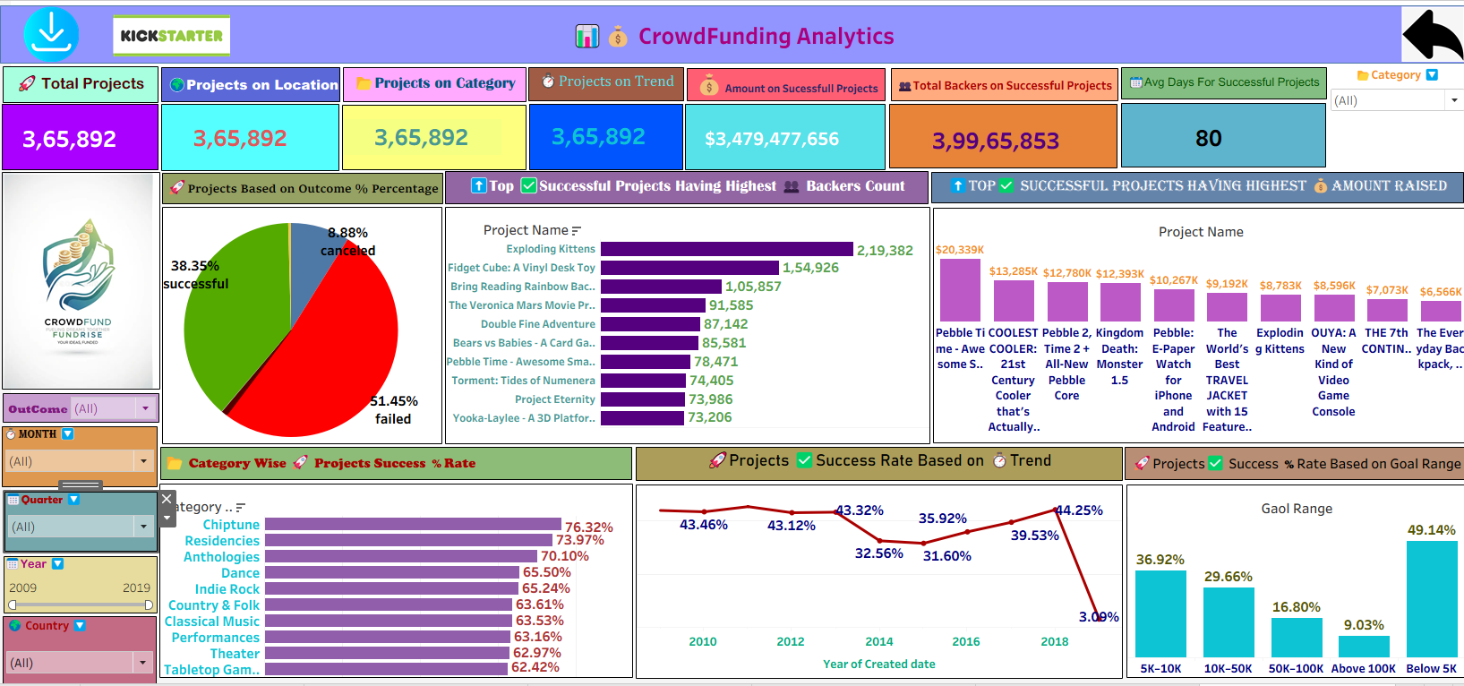
📊💰 CrowdFunding Analytics Dashboard :

Slide 10
✅ Conclusion :
We successfully completed the Crowdfunding Analytics project and identified key insights, trends, and patterns that helps creators increase project success rates. By analyzing data using Excel, Power BI, Tableau, and MySQL, we transformed raw data into meaningful insights through charts ,MySQL Queries and dashboards that Helps the Increase the More Successful Projects

Slide 11

THANK YOU

